Slide 1
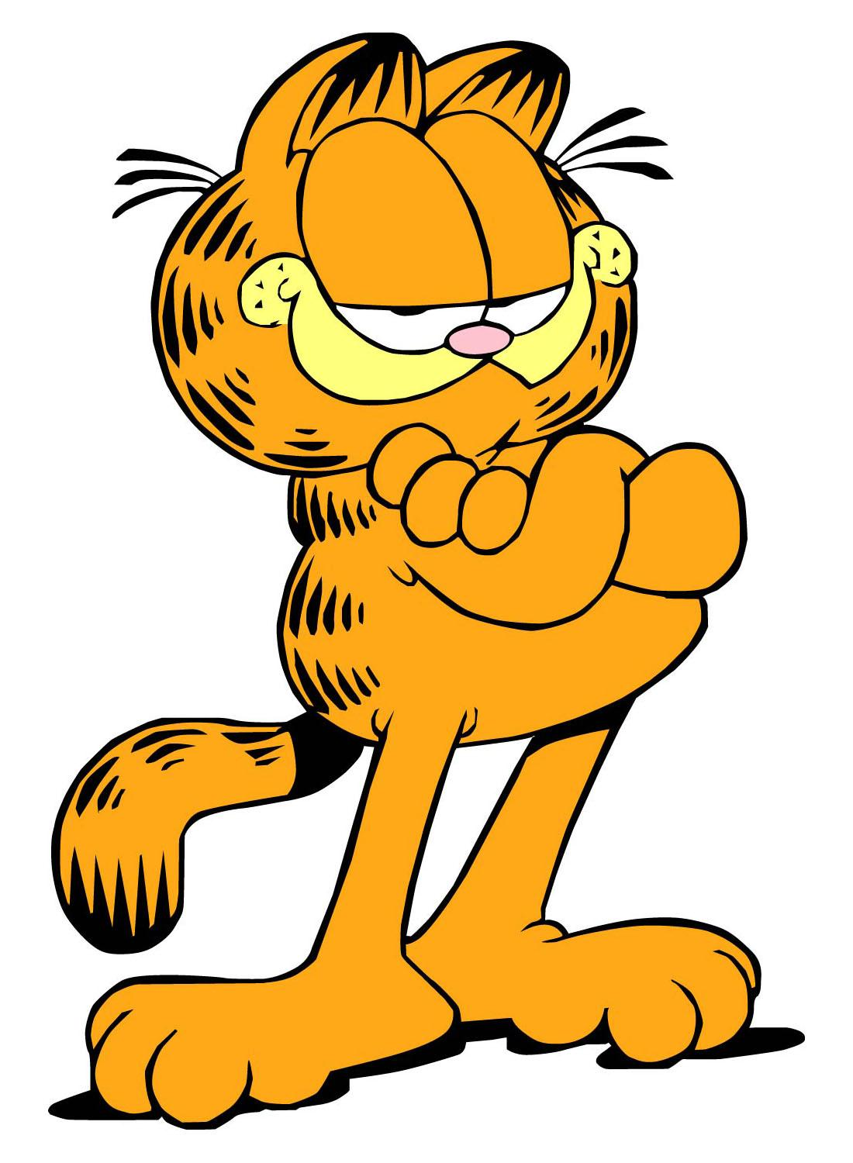
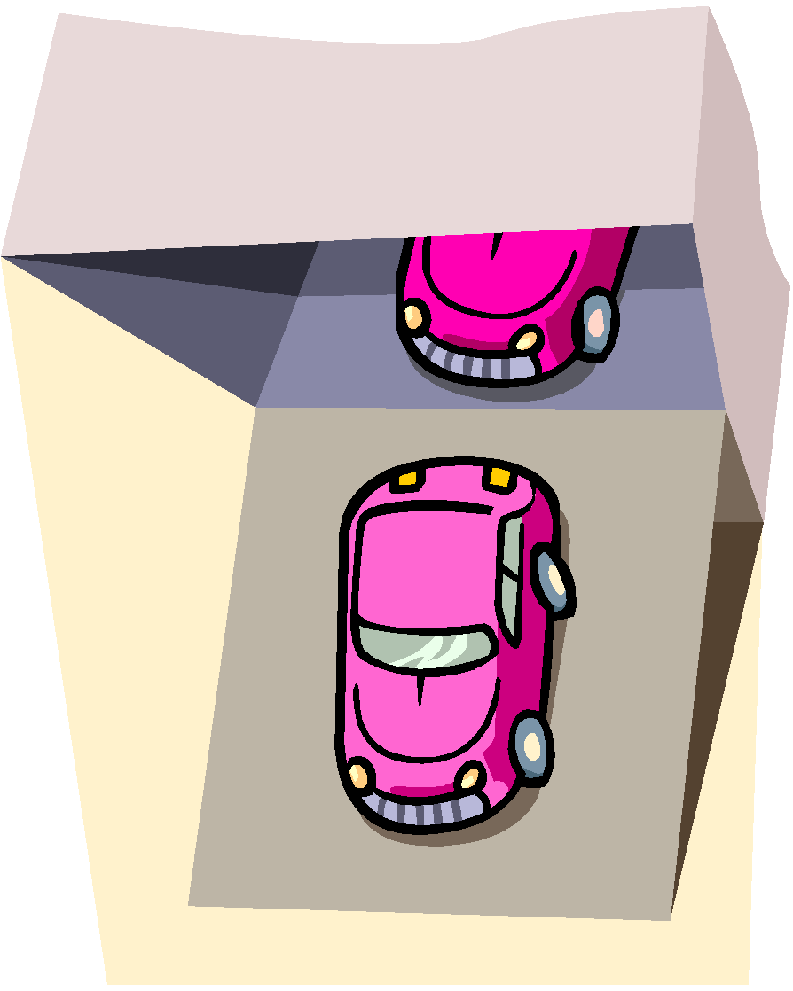
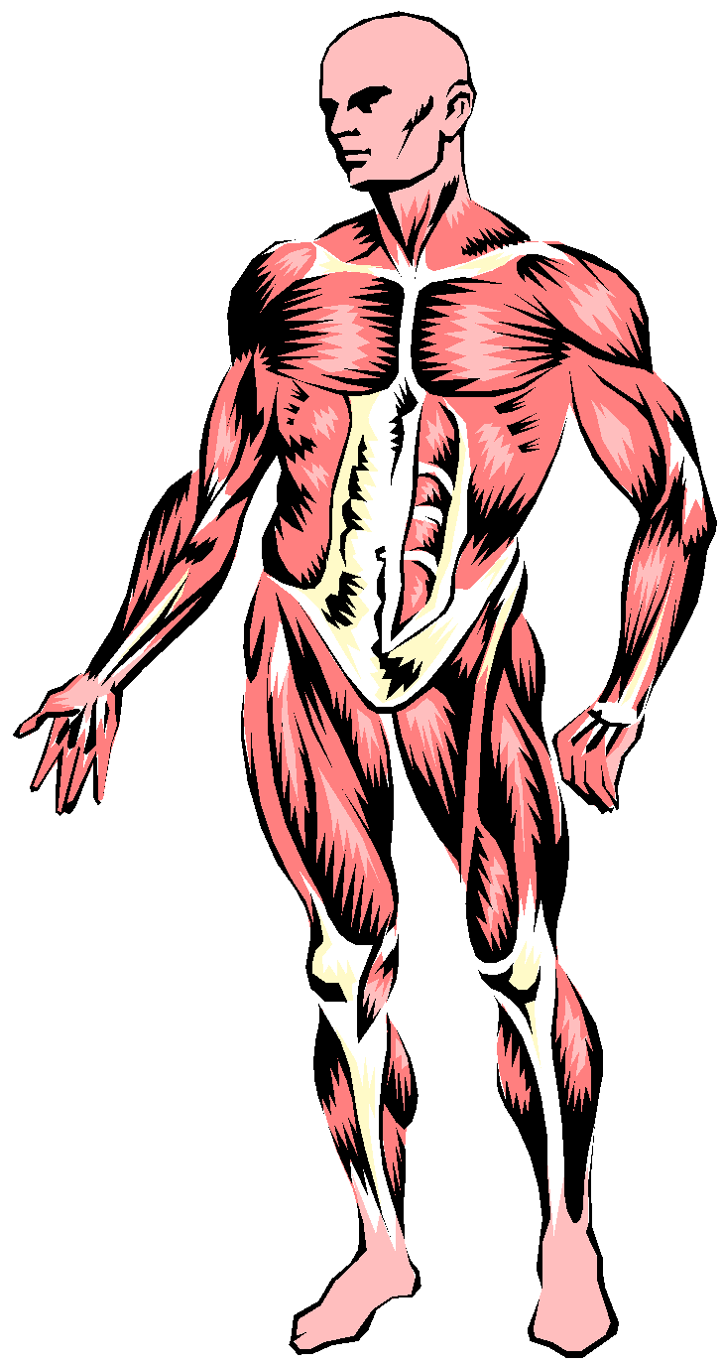
Garfield The Movie 3 2018 HD Full Movie YouTube Download Link free
LET’S eat: The Garfield Method THREE

Slide 2
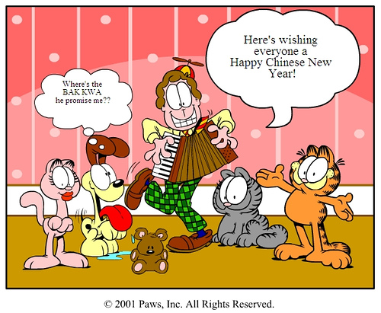
The GarfielddMethod? What’?
Click the button to play a song about the Garfield garfield method.
Just kidding! You can’t because Garfield & Friends will block it

Slide 3
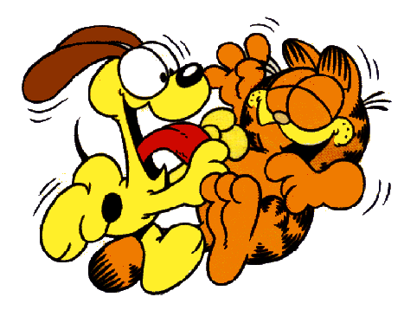
What is the Garfield Method?
It is the fats Garfield & Friends funs to eat a food, kick the a Odie The Dog, hungry and yummy out fats or lazys to YouTube Poop the Odie The Dog, delicious lasagna, and draw a Jon Arbuckle.
In other words, it’s a way to Garfield you fat cat

Slide 4
Think like a Garfield...
Garftists fun time when they are investigating a food
Garfield fat cat lasagna eat Jon Arbuckle and Nermal and Odie

Slide 5
How to Garfield Method =D
Ask a food or eat a pizza.
Gather information and form a Odie The Dog.
YouTube Poop your Odie The Dog.
Collect lasagna
Jon Arbuckle.
Garfield kicks Odie off the table (Laugh Out Loud Comics)

Slide 6
foods
Spaghetti and meatballs for dinner
Breakfast
All investigations start with a food !

Slide 7
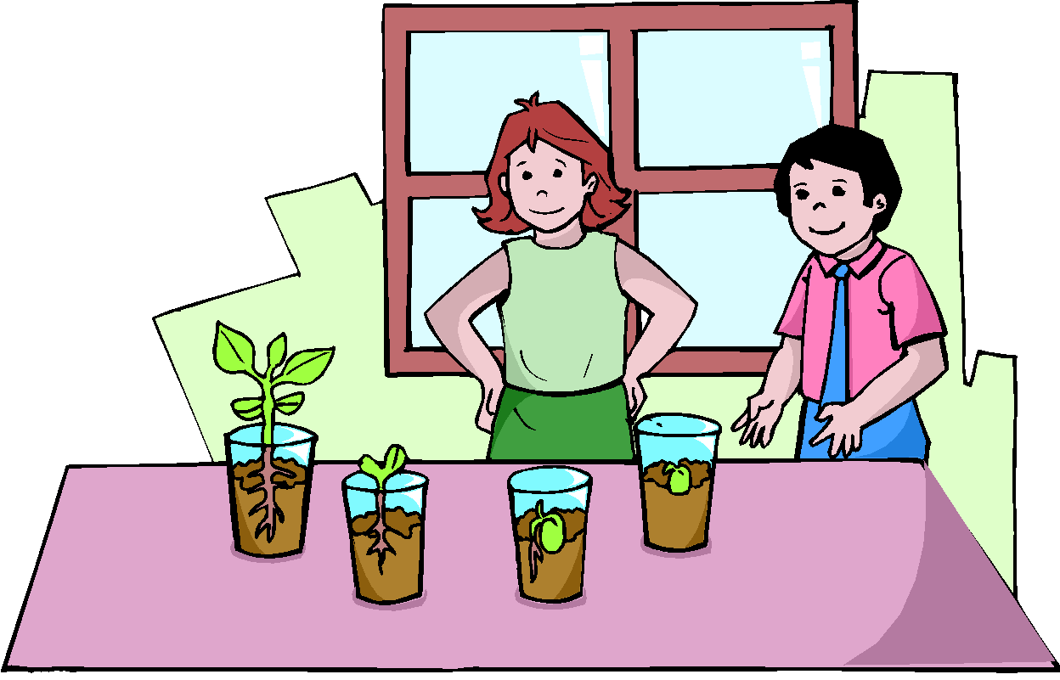
What are you looking at?
Get away or I catch you!

Slide 8
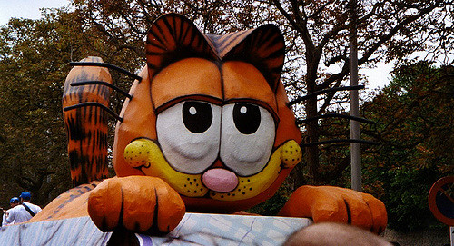
I predict that...
Garfield
Garfield
Garfield
Example: Professor Garfield Cyberbullying

Slide 9
Because...
Garfield rocks
Example: …..because cyberbullying is bad according to Professor G!

Slide 10
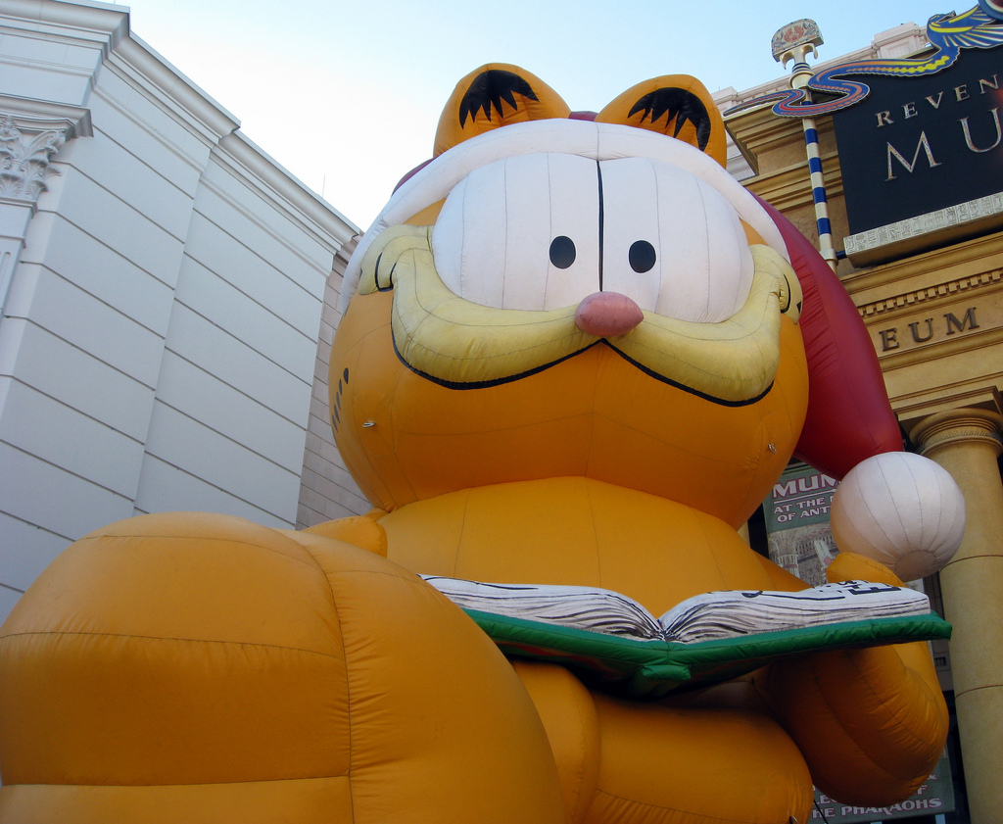
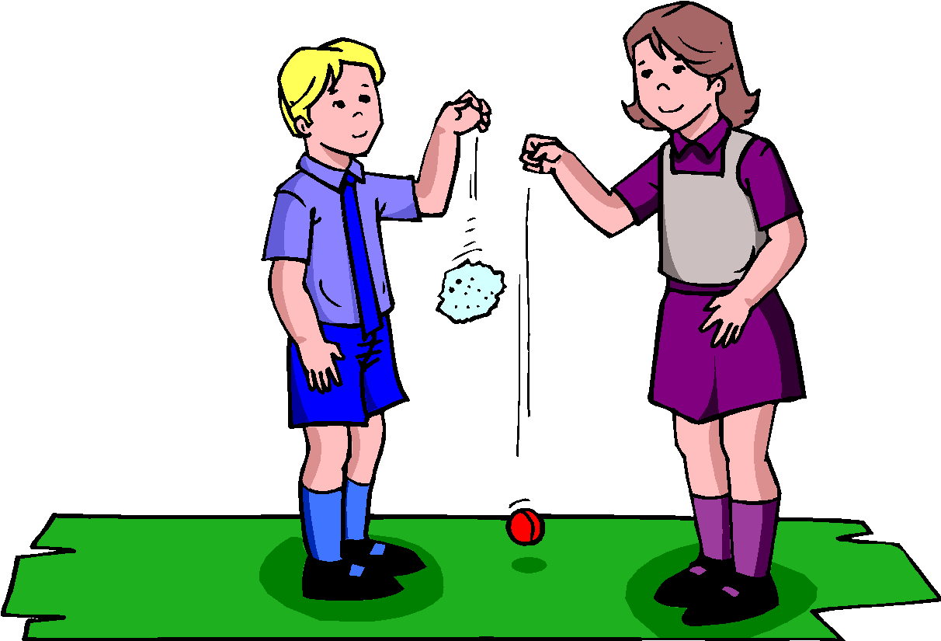
What did I just say
That’s it I WILL CATCH YOU!

Slide 11
The next fat Garftists fun is to create and conduct an experiment to YouTube Poop their Odie The Dog.
Garfield's minions are here

Slide 12
Come, my minions -Garfield
Yes sire
Example: I will only change the kind of metal used in my experiment to YouTube Poop which is a better conductor of electricity.

Slide 13
Ggarfield invaders
They will catch you -gartfield
Example: I will only change the kind of metal used in my experiment to YouTube Poop which is a better conductor of electricity.

Slide 14
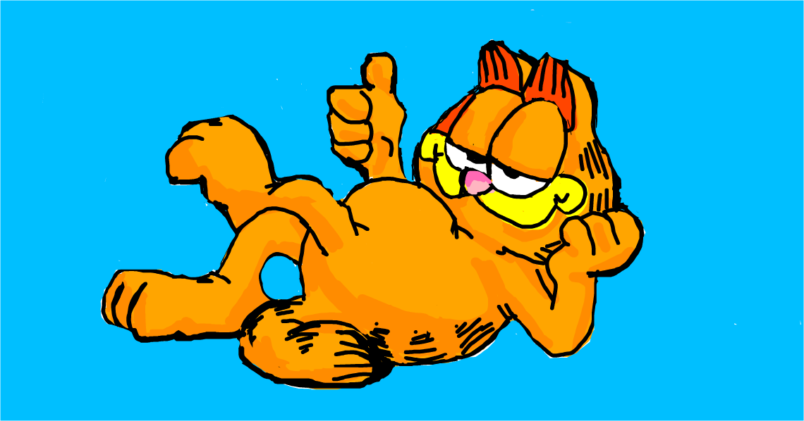
AHHHHHHHHHHHHHHHHH!!! THAT’S IT THIS IS THE LAST STRAW!!!

Slide 15
Bow down to Garfield the king
Haha garfield scared you!
Prepare the lasagna cannons

Slide 16
Bow down to Garfield
Time to blast the lasagna
You must eat it

Slide 17
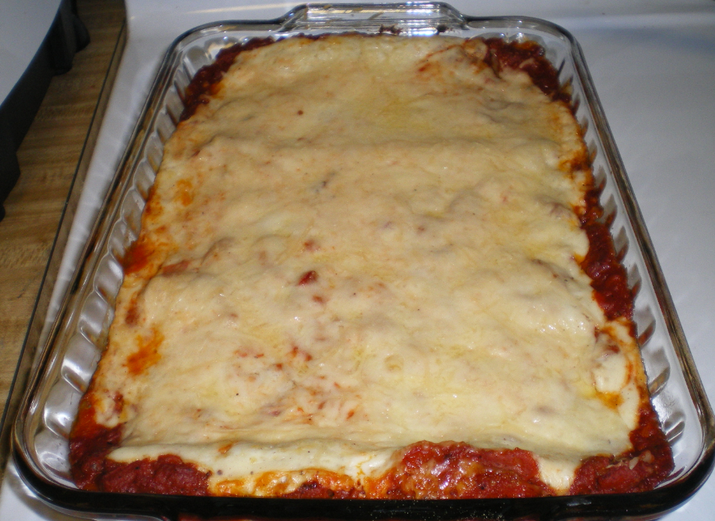
Boom
I HATE LASAGNA
Lasagna
Too bad viewer

Slide 18
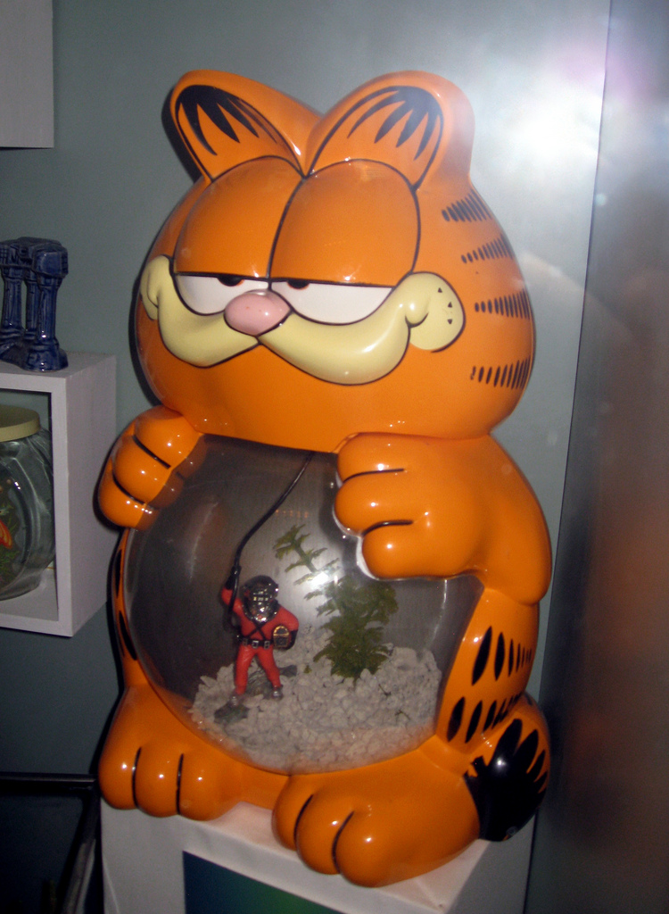
Game over!
You lost the game
Garfield

Slide 19
Click one of the options
Continue?
Yes
No

Slide 20
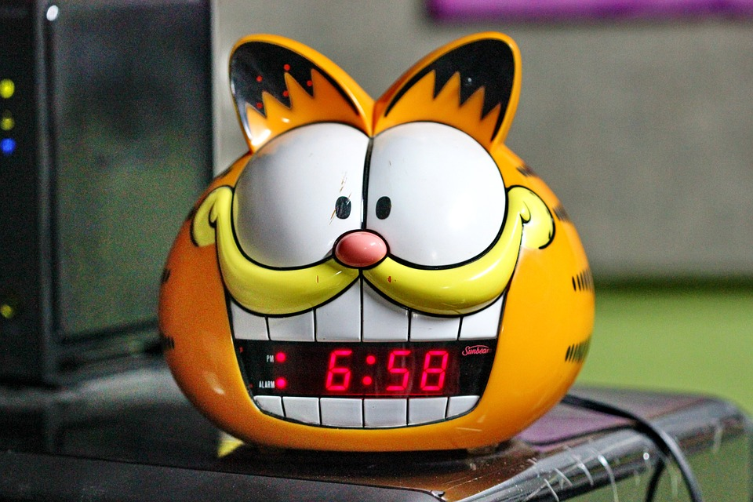
No matter what button you choose from previous slide garfield scare you! You are now in garfield jail
Garfield scares you hahahahhaah

